Slide 1

Sentiment Analysis of Yelp Reviews for Mexican Food
STAT628 Module 3 Group 10
Brian Tsai, Tinghui Xu, Lanxin Xiang

Slide 2
Motivation/Background and Goals
Data Cleaning
Preliminary Analysis
Future Plans

Slide 3
Motivation
We chose Mexican Food as our area of focus
We look at the top 2 largest Mexican food chains in US: Taco Bell and Chipotle
We look at the reviews and want to give business insight for the owners

Slide 4
Goals
Make comparisons between Taco Bell and Chipotle
Figure out what aspects reviewers care more about
Identify factors that affect Yelp review ratings
Ultimately: Give advice to Taco Bell and Chipotle to improve future ratings as well as provide tips for business owners who may want to open their own Mexican food chain

Slide 5
Data Cleaning/Filtering
Filter out Taco Bell and Chipotle restaurants from the business.json
Extract reviews from review.json
Exclude restaurants that aren’t open
Exclude restaurants with fewer than 10 reviews
Exclude reviews that aren’t in English

Slide 6
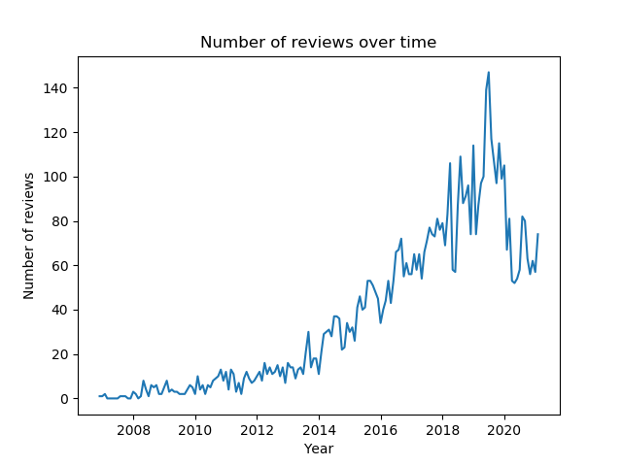
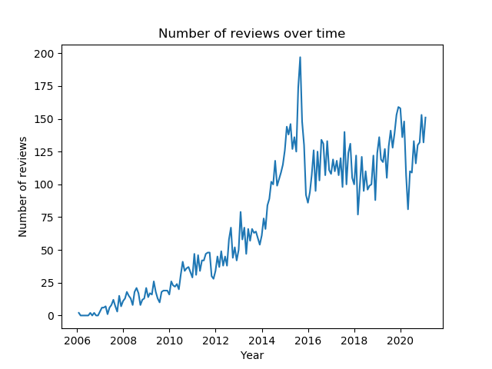
Overview
Taco Bell: Number of restaurants: 188 Number of reviews: 6139
Chipotle: Number of restaurants: 173 Number of reviews: 12679

Slide 7
Preliminary Analysis
From the data, we can first make some graphs to grasp the overall situation/trend at Taco Bell and Chipotle
Average Ratings
Distribution of Ratings
Word Cloud / word frequency
Sentimental score over time
Sentimental score of an aspect

Slide 8
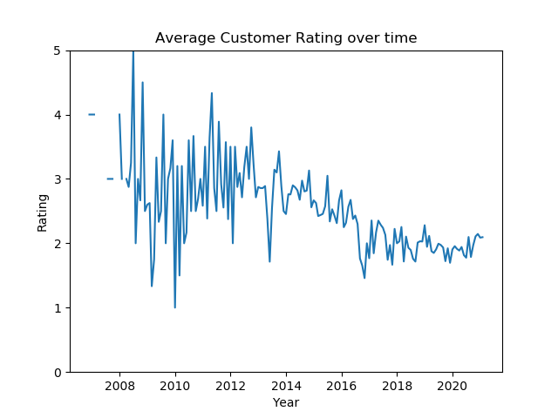
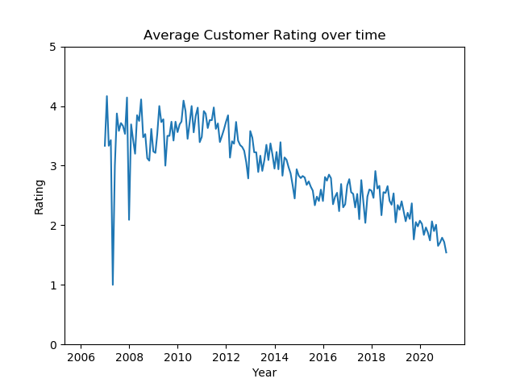
Average Ratings
Taco Bell: Chipotle:

Slide 9
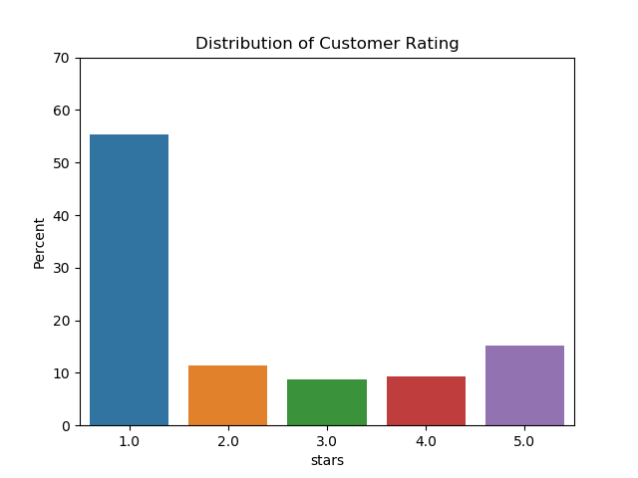
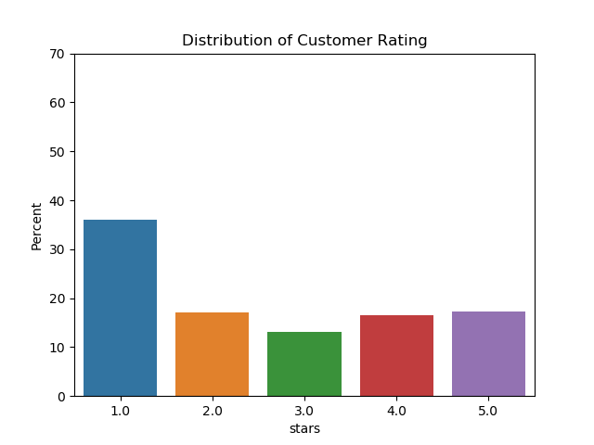
Distribution of Ratings
Taco Bell: Chipotle:

Slide 10
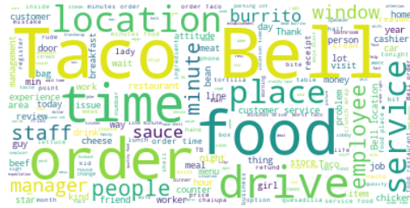
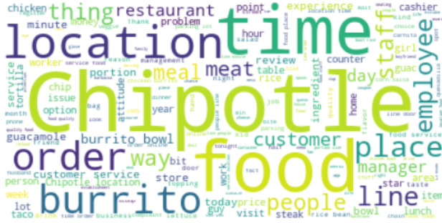
Word Cloud for nouns
Taco Bell: Chipotle:
Notes:
Taco Bell: Location, time, food, drive (drive-thru), services Chipotle: Location, time, food, burrito,

Slide 11
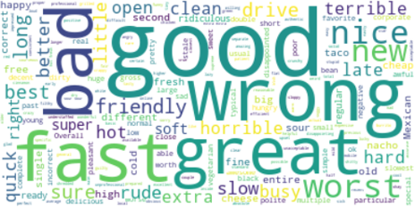
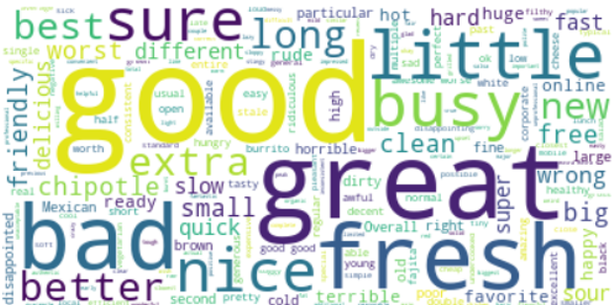
Word Cloud for adjectives
Taco Bell: Chipotle:

Slide 12
Review Top words
Taco Bell: Chipotle:
Word | Frequency
taco | 5967
bell | 4813
food | 4803
order | 3778
drive | 2333
time | 2332
service | 1978
location | 1852
minutes | 1528
place | 1348
Word | Frequency
chipotle | 12055
food | 9655
location | 6437
burrito | 5271
time | 5200
order | 4955
like | 4694
line | 4293
good | 3867
service | 3742

Slide 13
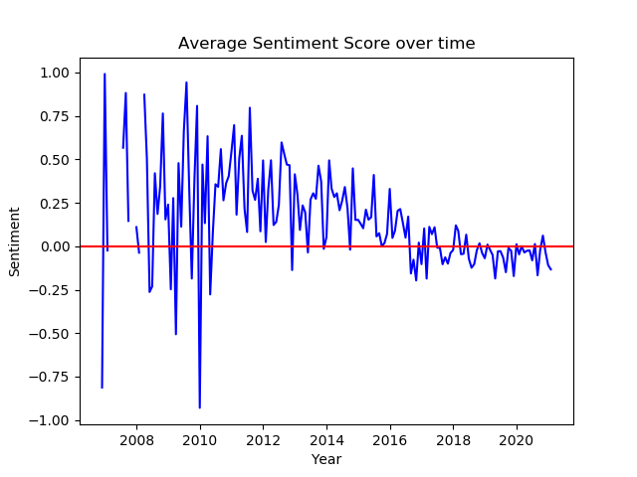
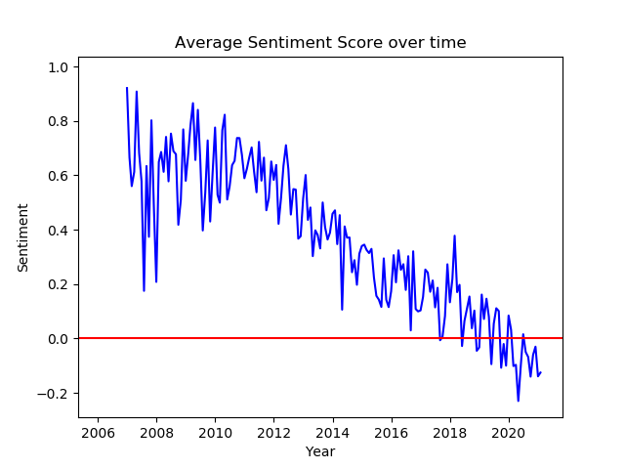
Sentiment Score
Taco Bell: Chipotle:

Slide 14
Aspect based example – food
Keywords: food, burrito, taco, chipotle, rice, sour cream, delicious..
Default words: fast food, food chains, taco bell, making the food, order food …
Review: This is possibly my favorite "fast food chain" per-say. Everything is amazing. The servers are always very nice are always willing to serve you more condiments if you ask for "more" of something. I especially love the guacamole that they make at Chipotle………
Segments: I especially love the guacamole that they make at Chipotle; It's almost as good as guacamole in Mexico; it never fails to taste amazing
Compound score: 0.6697, 0.3862, 0.7296, 0.6249

Slide 15
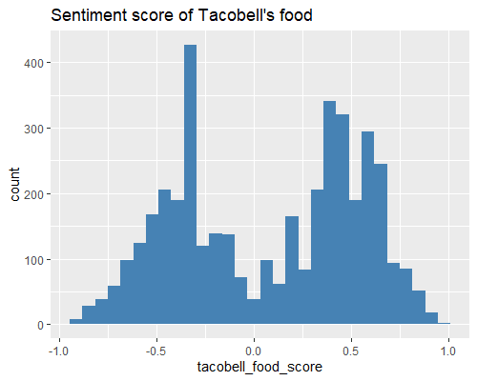
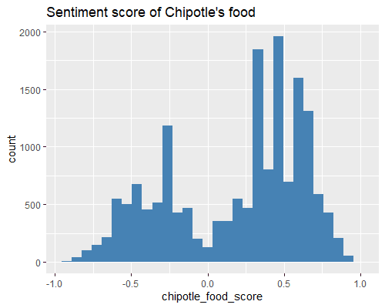
Food aspect sentiment graph
T-test: t = 13.628, p-value < 2.2e-16 95% CI: [ 0.042, 0.056]

Slide 16
Future Work
Build model focused on aspects such as Food, Service, Ambience, Time
Look for words associated with each aspect and calculate sentiment scores for each word
Somehow combine different scores into one overall score for each category
Attempt other methods such as Latent Dirichlet Allocation

